Slide 1
SUPPORT COMMITTEE & FINANCIAL 101
2019 ANNUAL
GENERAL MEETING
R. Charlene Orrell
Director, Liaison Officer

Slide 2
Responsibilities of the support committee
Recruiting Cadets

Slide 3
Responsibilities of the support committee
Recruiting CIC Officers

Slide 4
Responsibilities of the support committee
Fundraising

Slide 5
Responsibilities of the support committee
Provide Corps Training Facilities

Slide 6
Responsibilities of the support committee
Organizes / Conducts Cadet Recreational Programs

Slide 7
Responsibilities of the support committee
Provide Funds for Optional Training Activities

Slide 8
Responsibilities of the support committee
Provide Equipment to Cadet Corps not supplied by DND

Slide 9
Responsibilities of DND
Training CIC Officers
Provide Qualification Standards & Plans (QSP) &
Instructional Guides (IG’s) for Cadet Trg
Provide Funds for Mandatory Training & Support
Activities
Develop Policy regarding CIC officers; CI’s and Cadets
Issue Equipment to Cadet Corps IAW “scales of issue”
Provide Pay for CIC Officers & CI’s
Select Cadets for CSTC’s
Provide Facilities & Staff for CSTC’s

Slide 10
JOINT Responsibilities of acLC & DND
Forming or Disbanding Cadet Corps
Provide Awards & Medals
Develop Community & Media Relationships
Supervising & Administering Cadet Corps
Provide Reviewing Party for Annual Reviews.

Slide 11
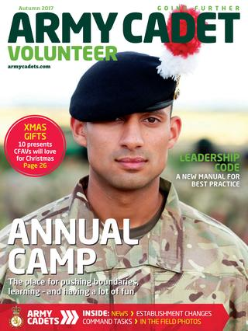
SUPPORT COMMITTEE ROLES
Chair
Vice Chair
Secretary
Treasurer
Fund Raiser
Public Relations
Volunteer Co-ordination
Sponsor
Other?
Support our Cadets
We Are Family

Slide 12
SUPPORT COMMITTEE Is Not!!
A parent committee:
- Members leave their parent hat at the door
- Not a voice for complaints from parents
Not part of the military structure
- Not a second Training Officer
- Not an audit or oversight to the CO
Not the public face of the Corps

Slide 13
Code of ethics for league members & volunteers
Represent The League with professionalism, dignity and pride, and be responsible for conducting yourself with courtesy and appropriate behaviour.
Follow through and complete accepted tasks.
Conduct myself in a respectful manner, exhibit good sporting conduct, and be a positive role model for the Cadets.
Display respect and courtesy for employees, DND staff, other volunteers, program participants, visitors and property.
Respect the privacy of persons served by the organization and hold in confidence sensitive, private and personal information.

Slide 14
Code of ethics for league members & volunteers
Will not use cell phone or text messages during a Support Committee meeting.
Work cooperatively as a team member with employees, DND and other volunteers.
Keep personal opinions and actions separate from those made as a representative of this organization.
Avoid conduct, both on and off duty that would jeopardize program effectiveness.
Never use the Cadet Corps funds as assets for any unlawful or improper purpose.

Slide 15
Code of ethics for league members & volunteers
Ensure that the Corps financial records and accounting is up to date.
Volunteers/Members are not entitled to any remunerations or salary.

Slide 16
Requirements to be on a support committee
Professionalism, Dignity and Pride
Responsible
Respectful Manner
Courteous
Positive Role Model
Co-operative
Organized and Accountable
Non-Exclusionary
ALL MEMBERS OF THE SUPPORT COMMITTEE MUST BE SCREENED

Slide 17
Support committee members will not!!
Solicit gratuities or gifts for personal gain.
Be under the influence of drugs or alcohol at any cadet events.
Discriminate based on race, religion, sex, age, nationality, economic or material status, disability or sexual orientation.
use vulgar or inappropriate language.

Slide 18
Support committee members must
Hold and attend regular meetings with the Commanding Officer. The Commanding Officer is the Ex Officio member of the Committee.
Follow Army Cadet League guidelines.
Demonstrate confidence and support of the Commanding Officer.
Work co-operatively for projects such as fundraising and recruiting.

Slide 19
Support committee members must also commit to succession planning
Should have someone in mind to take over your duties if required
discuss your Succession plans with the Liaison Officer and CO
Have back-up in mind for all Support Committee positions
Have Support Committee members mentor colleagues
Establish a Rule of the Support Committee that you agree to serve a full cadet year and that if you leave, you agree
to:
Identify a successor
Mentor that successor
Give sufficient notice
Leave behind detailed notes and instructions

Slide 20
Conducting business Part 1
Hold regular meetings with ample notice
Have a specific agenda for every meeting
Give an opportunity for people to add agenda items – get agenda agreement
Establish norms for conduct in advance:
- Decide who can speak on various topics (e.g. members only, visitors, executive)
- Don’t speak until permitted by chair (optional)
- No off topic discussions, no cell phones
- Yield the floor when so directed

Slide 21
Conducting business part 2
- Actions/decisions can be challenged, not the person
- Consequence for unacceptable behavior (yelling, vulgarity, etc.)
- Everyone gets to speak on a subject until they are satisfied (within reason), once something is decided, entire group supports it. If you can’t support a SC group decisions then perhaps you should resign.
When a decision is required:
- Have a motion and a seconder ---- no seconder = no discussion
- Allow discussion but set a time limit

Slide 22
Conducting business part 3
- Attempt a compromise “Would you be happier if we only committed to this once to see how everything goes and vote later to continue?”
- Get a specific motion or statement to vote on. Explain that you expect entire committee to respect the majority.
- Have a clear vote, if necessary use ballots.
- Rally around a decision.
- Call for a vote, acknowledge the result clearly.
- Documents the vote, allow dissenters to be recorded if they wish.

Slide 23
Conducting business part 4
Always prepare minutes – they provide protection, visibility and clarity:
- Time and date
- List of attendees
- Agenda is clear
- All decisions recorded
- Suggestion: Secretary reads how he/she will record discussion and gets general agreement
- Do not track verbatim discussion unless specifically asked

Slide 24
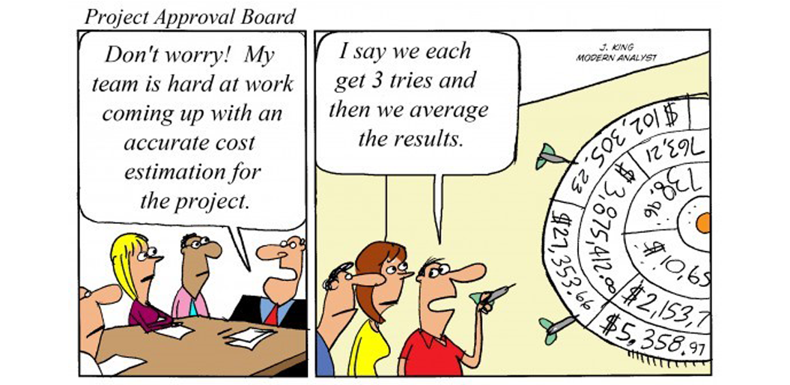
Finances - part 1
NO BLANK CHEQUES
- Do NOT pre-sign blank cheques. You will be held responsible if the cheque is used improperly.
SIGNING AUTHORITY
- 2 Non-related members of the support Committee must sign each cheque.

Slide 25
Finances – Part 2
DEPOSITING CASH
- Two members of the Support Committee must take any cash to the bank for deposit. Must bring back proof of deposit to the Support Committee.
OVERVIEW OF BANK ACCOUNT
- Bank statements from the previous moth are to be presented to the Support Committee during the monthly meetings, every month.

Slide 26
Finances – Part 3
TRANSPARENCY
- Financial information and bank statements should always be available to the Commanding Officer as well as the Support Committee

Slide 27
Financial dates to remember
Cadet Financial Year to September 1st to August 31st
October 31st – Financial Statement to be delivered to League Office
March 31st & October 31st – HST Remittance
November 30th – Assessment Fees Due
June 1st – Content Insurance is due
December – Local Support Allocation to be submitted to DND for items such as FTX Expenses, Postal Box, Internet to be claimed once a year.

Slide 28
Additionally
Be familiar with all documentation circulated by the League Office
Refer to League website www.armycadetleague.on.ca under “Forms & Docs”

Slide 29
QUESTIONS ????
Question and Answer Period…

