Slide 1
RCSU (Pacific)
Lieutenant-Colonel N.R. Head, DCO

Slide 2
MISSION
The Mission of the Natl CJCR Sp Gp is to: support and deliver a Cadet Program that contributes to the development and preparation of youth for the transition to adulthood, enabling them to meet the challenges of modern society, through a dynamic, community-based program; and support the delivery of the JCR Program by the Canadian Army (CA) which provides a structured youth program and promotes traditional cultures and lifestyles, in remote and isolated communities in Canada.

Slide 3
Notes:
An average month also sees the Cadet program appear in BC media between 15-45 times, which means that someone is talking about the Cadet Program in the media on average every day of the year.

Slide 4
RCSU Staff Update
RCSU CO: Commander D.B. Henderson
RCSU CWO: Chief Petty Officer 1st Class D. Bliss
Chief of Staff: Major G. Clarke
OIC Reg Trg: Major S. Bissell
OIC Interior: Major M. Novak
Zone Trg O’s: Captain Adams returning (Capt King Backfill)
Captain Dalgleish replacing Captain Hamilton
Captain Smith replacing Captain Dykeman
RDA Discretionary: Captain B. Justason
Notes:
Maj Clarke back from parental leave
Maj Bissell in Victoria on 15 Oct (currently covering both OIC Interior and OIC Regional Training)
Maj Novak begins Class B on 1 Nov
Capt Adams returns on 7 Oct, Capt King’s last day 15 Oct.

Slide 5
Army Cadet Corps Overview
49 Army Cadet Corps from Victoria to Fort St John
1 Army Cadet Corps Disbanded
Notes:
49 Army Cadet Corps from Victoria to Fort St John
Disbanded: 2308 RCACC in Port Alberni
Army Cadet Populations:
16/17: 1984
17/18: 1962
18/19: 1872

Slide 6
Army Cadet Activities
Maple Resolve
CAF Familiarization
Pre-Para
Expedition Training
Green & Red Star (Delivered at Corps)
Silver & Gold Star (Regionally Delivered)
Regional and National (RDA/NDA)
Notes:
Maple Resolve
– CA level exercise at CFB Wainwright in May every year
– Cadet participation is five days (during the school week) living out in the field with the CA experiencing a large scale exercise.
– 2 cadets from Pacific – 16 Nationally.
CAF Familiarization
– New position – J5 Plans NCM (CAF Famil) - MWO Rick Barker (PPCLI) posted in July 2018, previously the ACICO (now AEA’s) organized these activities.
– MWO Barker has met and briefed all the Ops O/Ops WO at 39 Bde on their roll and that RCSU (P) has funding to support these activities.
- Activities can be a single day or a weekend FTX depending on the scope of training and the age of cadets participating.
- Types of activities could be: C7 shoot, regimental history, SAT simulator, vehicle and weapon demonstration, bridge and demolition observation, FTX participation.
Pre-Para
– Will be conducted on 13-17 Feb 2020 – at PRTC in Chilliwack
– 12 to 16 cadets will be invited to attend training, application are due by 6 Dec 19 in Fortress and selections will be made by 16 Dec 19
5 cadets and 2 spares will be recommended for the CAF Basic Parachutist course after the completion of training
Cadets must be medically cleared by a CAF Physician before they will be course loaded.
Expedition Training – The identity of the Army Cadet program (Sea- Sailing, Air – Flying, Army – Expeditions)
– All Army cadets participate in expedition activities
- Green and Red star cadets (1st and 2nd year) conducted at the Local Training level (Navigation/Trekking FTX conducted by Corps staff)
- Silver and Gold star cadets (3rd and 4th year) conducted by the RCSU (P) as a Regionally Directed Activity – activities are organized by the J3- Trg O (Expeditions) throughout the trg year. Army Cadets must attend a Silver or Gold Star expedition to complete the required PO to pass their star level.
- Gold Star and Master Cadets (4th to 6th year) Regional & National Expeditions – 2 to 3 planned Regional Expedition for 2019/20 for and 2 National Expeditions organized by the J3 – Trg O (Expeditions) in Pacific or the host region.

Slide 7
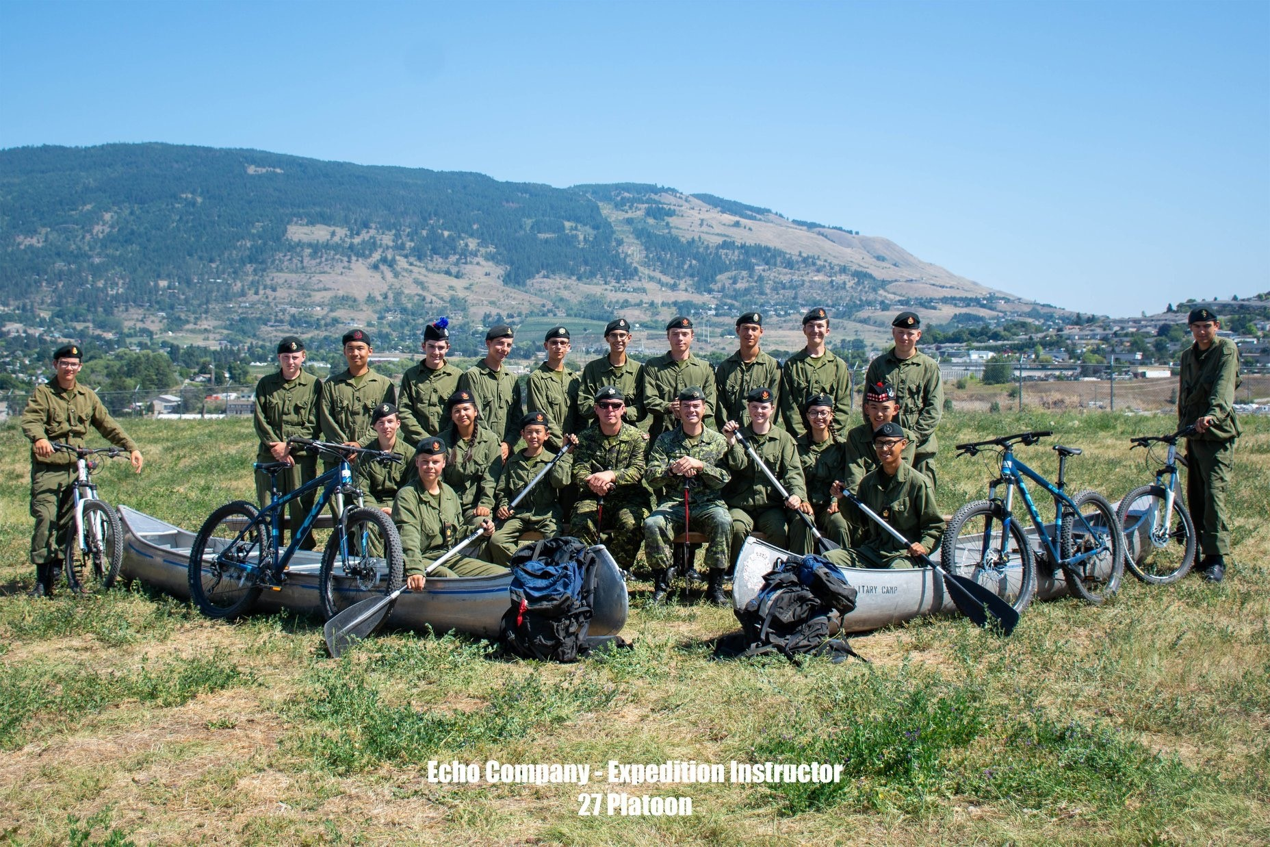
Expedition Training (Sites)
Expedition Training 2018-2019 Training Year:
Silver Star Expeditions:
8 Silver Star Expeditions conducted in the Interior, Greater Vancouver, and Vancouver Island
Approx 350 cadets trained
Gold Star Expeditions:
6 Gold Star Expeditions conducted in the
Interior, Greater Vancouver, and
Vancouver Island
Approx 300 cadets trained
Notes:
- Silver Star Expeditions – March-May 2019 – 8 Expeditions (various sites) - 350 Cadets trained. Cadets are introduced to expedition skills training and are able to participate in canoeing and mountain biking.
- Gold Star Expeditions – Sept 2018 – May 2019 – 6 Expeditions (various sites) – 300 Cadets trained. Cadets build on previous expedition skills and get an opportunity to develop leadership skills in the outdoors.

Slide 8
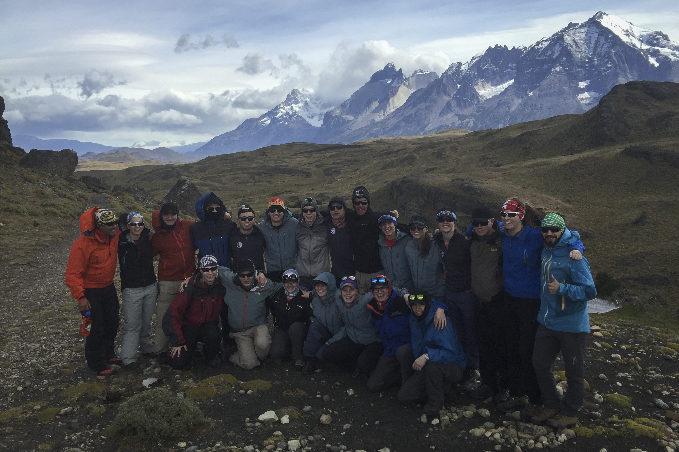
Expedition Training
Expedition Training 2018-2019 Training Year:
Professional Development Clinic for Senior Cadets:
35 Army Cadets attended a weekend PD clinic in Feb 2019 to assist them in delivering expedition training at the site and corps
Regional Expeditions:
Wild Winter Challenge Regional Expedition – 14 cadets Backcountry Skiing, Winter Camping, Trekking in Manning Prov Park Dec 2018
West Coast Challenge Regional Expedition – 20 Cadets Sea Kayaking and Mountain Biking around the Gulf Islands May 2019
Notes:
- Conducted Two Regional Expeditions for 18-19 trg year. Regional Expeditions are for Army cadets who are at least 15 years old, completed their Gold Star Training Program, and able to achieve Bronze on the Cadet Fitness Assessment.
- Winter Challenge – 12 Senior Cadets, Backcountry Skiing, Winter Camping, Trekking in Manning Park - Dec 2018
West Coast Challenge – 20 Senior Cadets, Kayaking and Mountain Biking around the Gulf Islands – May 2019
35 Senior Army Cadets from across the region participated in a professional development clinic (Feb 2019) which provided training to perform duties as an expedition staff cadet at expedition sites

Slide 9
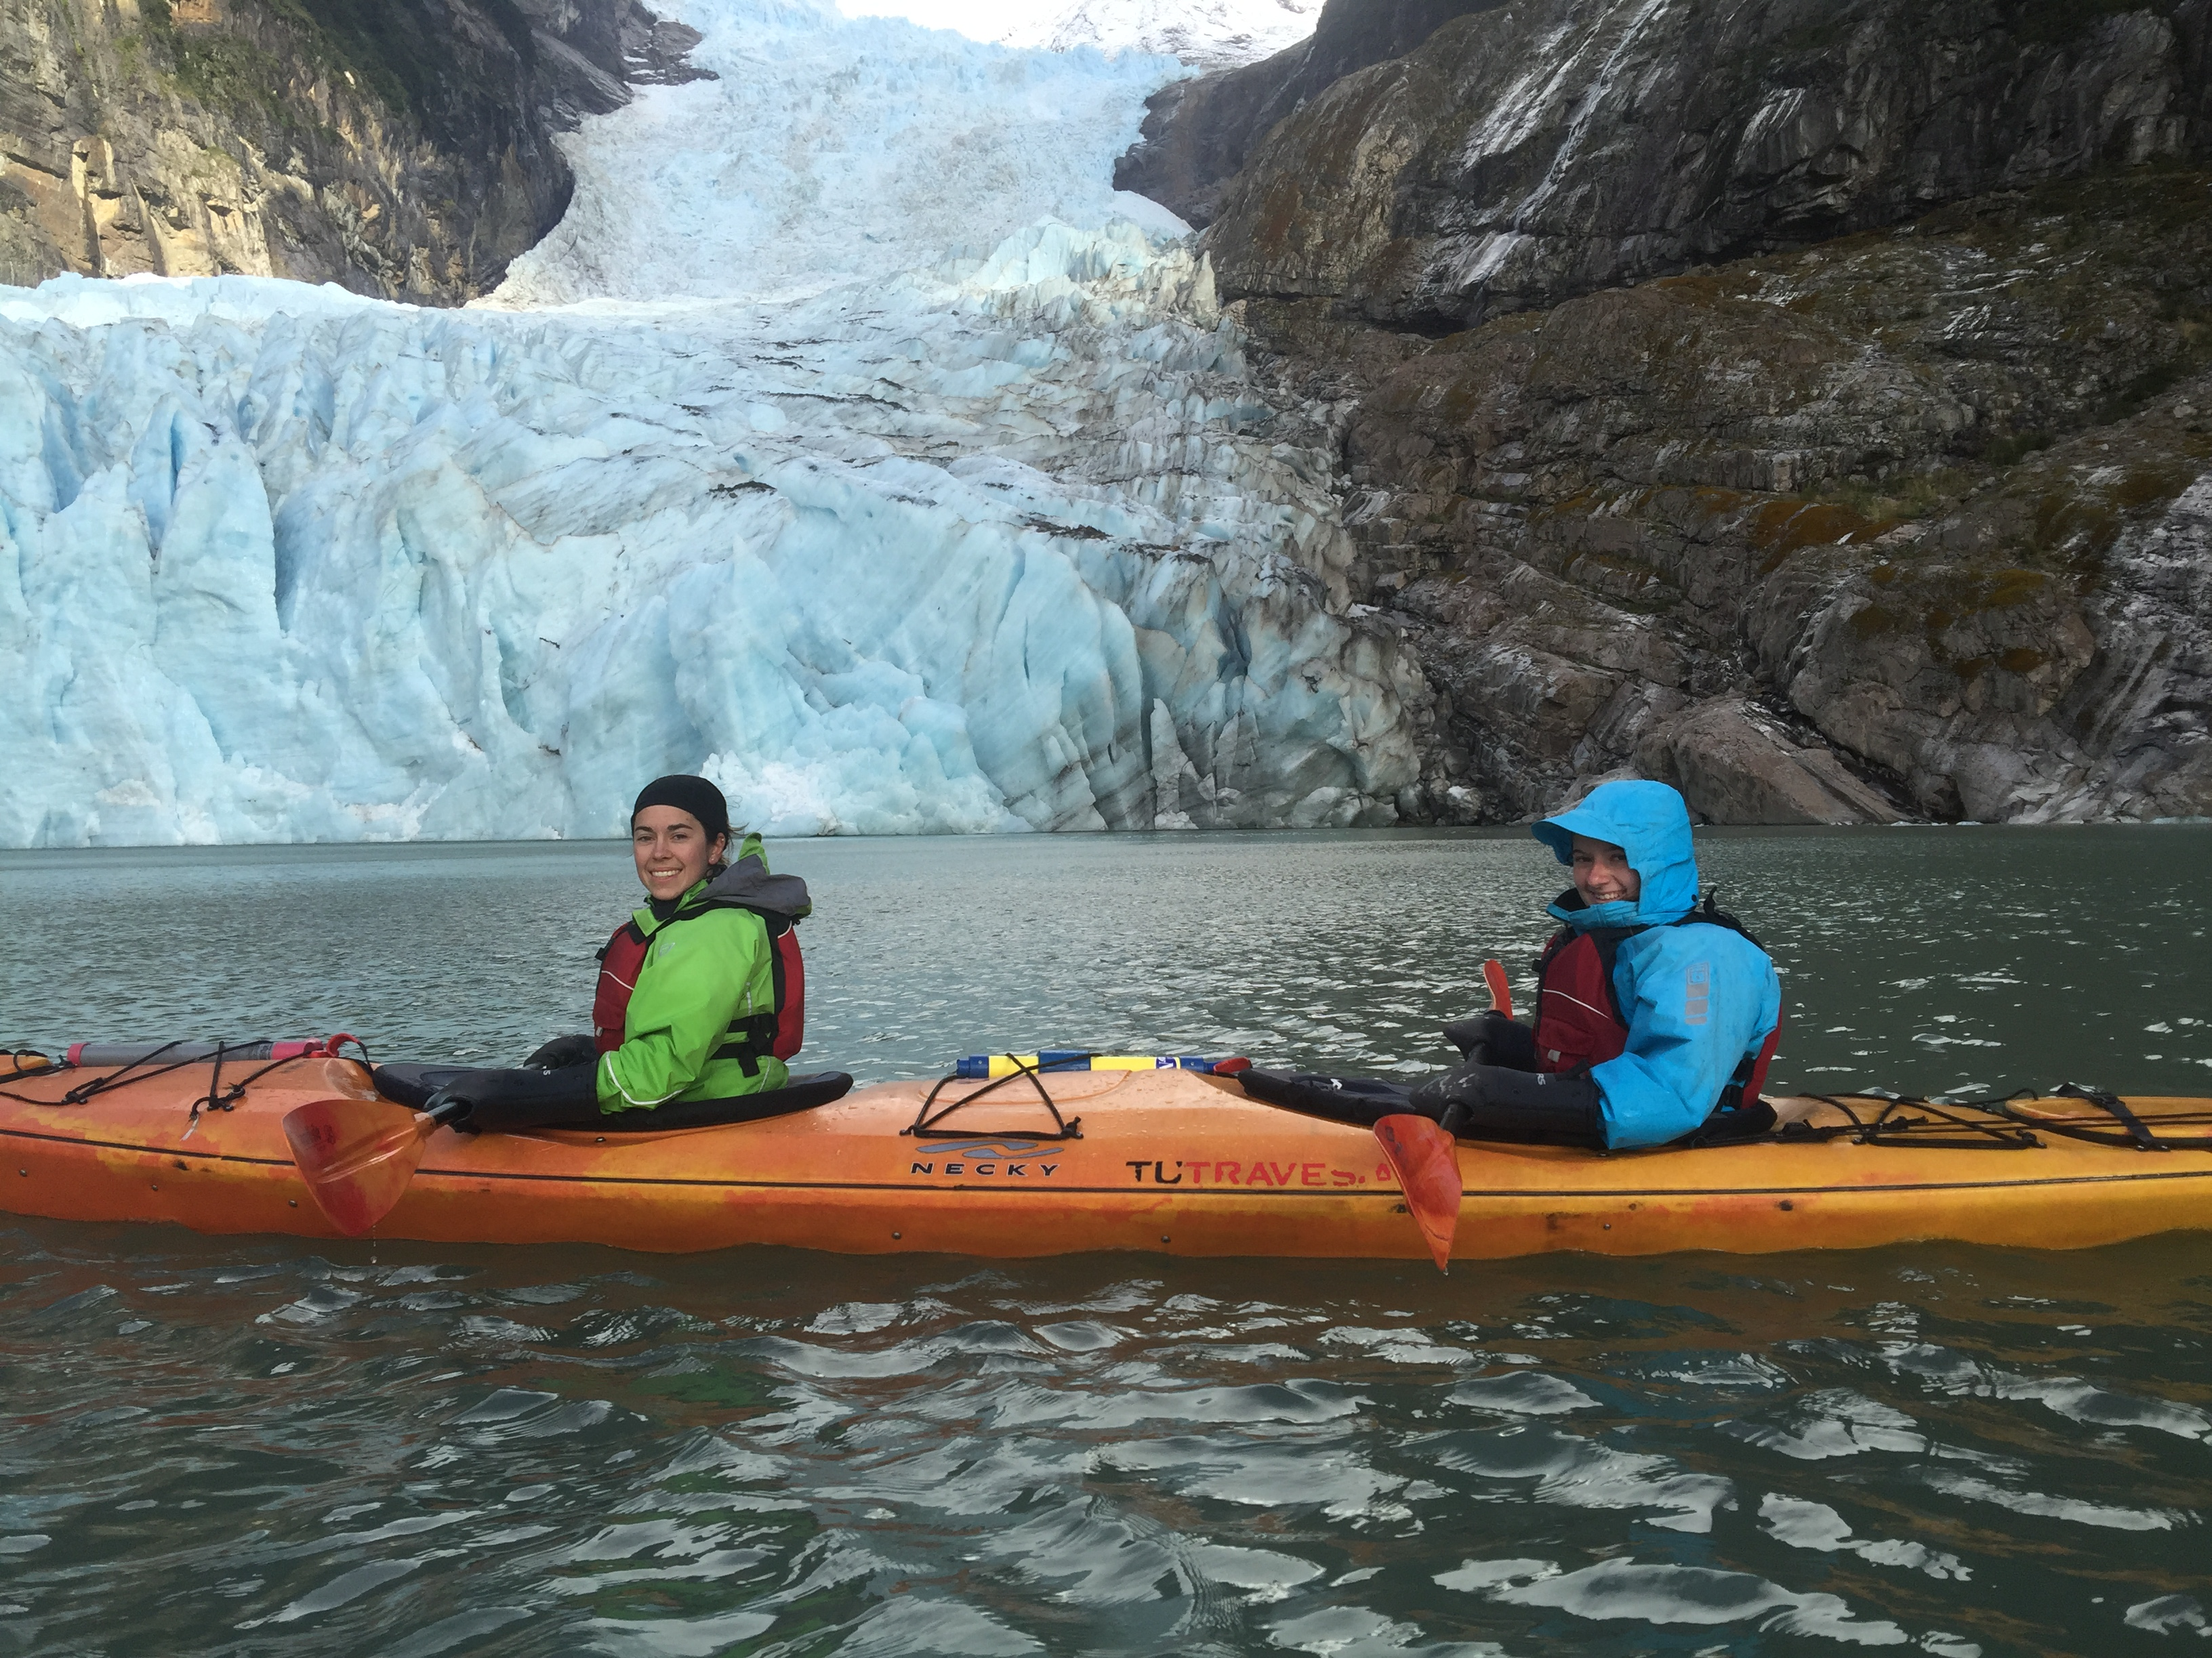
Expedition Training
Expedition Training 2018-2019
National/International Expeditions:
RCSU (P) hosted the International Expedition to Chile in Feb 2019. 18 Cadets attended from across Canada (two cadets from Pacific Region) Sea Kayaking and Trekking in Torres del Paine National Park.
RCSU (NW) hosted the National Expedition in Alberta in Aug/Sep 2018. 18 Cadets attended (two from Pac Region) Mountaineering and Mountain Biking in the Rocky Mountains.
Notes:
International Expedition hosted by Pacific Region for the fourth consecutive year.
18 Senior Army Cadets kayaked and trekked in Torres del Paine National Park in Chile. Pacific Region sent two cadets on the International Expedition.
RCSU (NW) hosted the National Expedition in Aug/Sep 2018 in the Rocky Mountains.
18 Senior Army Cadets mountain biked and mountaineered in Cochrane Alberta for two weeks. Pacific Region sent two cadets on the National Expedition.

Slide 10
Partnership
One of our Commander’s top 5 priorities is to:
Maintain and strengthen partnerships
Foster collaboration at all levels:
Local (Corps/Sqn, Branch/SC/SSC, Community Organizations, Community Leaders, etc.)
Area (RCSU Staff, League Reps, Affiliated Units, etc.)
Region (RCSU Staff, Leagues, Support Bases, D of E, etc.)
National (HQ Staff, Leagues, Canadian Centre for Child Protection, D of E, etc.)

Slide 11
Roles
QR (Cadets) is our foundational document on responsibilities.
DND | League | Local Sponsor
Supervision and Administration of Squadrons | Making recommendations on formation and disbandment | Making recommendations on formation and disbandment
Training Program & Policy | Providing & Supervising Local Sponsors | Accommodations not provided by DND
Financial and Material Resources | Trg Equipment and Funding not provided by DND | Trg Equipment and Funding not provided by DND
Staff Trg & Management | Attracting local adults and cadets | Attracting local adults and cadets
Squadron CO must approve cadet participation for all activities.
Notes:
MoU is under review.

Slide 12
Fundraising and Fees
Letter issued from Formation Commander to Corps/Squadron CO’s in Feb 2019:
“The inability of a cadet to contribute financially will have no impact on participation in any CCO activity (to include attendance at Cadet Training Centres), nor on eligibility for promotion.”
“Promotional efforts and public awareness campaigns by your unit on social media and other communication means should not include discussion concerning fees!”
No cadet will be turned away for financial reasons.
Notes:
Fee/fundraising are a League / Sponsoring Committee responsibility
Suitability is the CO’s responsibility.

Slide 13
Screening of Volunteers
All volunteers working at a squadron must be approved by the Squadron CO
This includes not only volunteer instructors, but anyone who regularly attends cadet activities and provides any form of volunteer service
A volunteer agreement (Cdt #139) must be completed as per CATO 23-07 and be submitted to the RCSU (Pac) J1 section
PRC / VSS is required for all volunteers working at a squadron
Notes:
If you are providing direct support to the CO of the Sqn in delivery or supervision of cadets then you are volunteering in support of the DND program, and need the CO’s authorization and require to be screened PRC and VSS. Examples are Canteen, Supply, Duke of Ed, training activities etc.
The points on the last 2 slides was presented to all of the Corps and SQN COs 2 weekends ago at our Regional CO Conference.

Slide 14
Public Affairs
COs Guide to Basic Public Affairs
Best practices and resources for public affairs at the corps level
Print Materials & Promo Videos
Available on the File Repository, accessible by anyone
Local printing using LSA or branch funds
Do not create your own products
Promotional Materials
No longer available, do not expect more to arrive
Engage your Cadet Correspondents & Zone UPARs
3 workshops this year, 38 spaces
Notes:
The CO’s Guide to Basic Public Affairs is a document created by the PAO that includes guidance and best practices for corps-level public affairs. Please refer to this document first.
Print materials that can be personalized to any corps or squadron are available on the File Repository. Any person can sign in to this by creating a user account, click on the left hand side for cadets/parents/sponsors or League members:
https://portal-portail.cadets.gc.ca
Once you are in, click on the Public Affairs folder, and then click Print Products; these are print-ready files for brochures, bookmarks, posters and banners. This is also where you can download copies of our current videos.
The current print products are branded with “I Am A Sea/Army/Air Cadet” (look and feel of PPT slideshow). These products can be personalized to each corps by opening the document and clicking on the blank space and entering local parade and contact information.
Corps and squadrons are now responsible for printing their own promotional materials from these files, but they are not to generate their own posters or brochures; LSA funding can be used to pay for print materials.
Promotional give-away items (pens, lanyards etc) are no longer available from RCSU (Pac) and it is not expected that we will be getting a new shipment. Corps that would like to order their own promo items may work with the PAO for branding.
Other PA Points
A reminder that 3 Cadet Correspondent Workshops will be held this year, the schedule is available on SharePoint, and that Zone UPARs are a great resource for first-line advice.

Slide 15
Financial Update
We were provided less funding this year
Analyzing options to maintain similar support as provided last year
Must continue to identify the most cost efficient means to deliver our training
No direct impact to delivery of local program
Notes:
Allocation to date -$1.2M
Predicted shortage -$1.4M
This does not include the $$1.3M pay equalization to be provided by TB
No direct impact to delivery of local program (Task 1)
Only asking that Local Supported Training days 9 and 10 be scheduled after 1 Apr 20 so we can fund out of next year’s budget.
We are working with Formation in Ottawa to resolve.

Slide 16
Local Support Allocation (LSA)
No reduction in your LSA
Category restrictions removed
Category 1 – Optional Training Activities
Category 2 – Optional Physical Activities
Category 3 – Administrative Support
Spend allocation early–submit invoices prior to 31 Dec
Online package available to Corps Staff on SharePoint in “Library” under “J8 Claims & Invoices.”
Call LS Noemi Brunet at 250-363-7345
Notes:
The online package includes a spreadsheet showing the allocation and current balance for each corps/squadron.
We understand that your Trg year is Sep to Jun but our FY is Apr to Mar.
We need your receipts early to ensure that they get covered.
Last year, ending 31 Mar 19, we still had 23% of the Army LSA unspent ($27,000)
This year, which commenced 1 Apr 19, we have received receipts for only 7% of the allocated Corps funds of $107,000.
Handouts are available for all Corps as to where you stand as of today.

Slide 17
Local Support Allocation
Current Allocation (All Army Cadet Corps) | $115,185.00
Current Claims Processed | $7,734.37
Remaining Balance | $107,450.63
Invoices Due 31 December 2019
Notes:
Please submit LSA Invoices by 31 Dec 2019 and do not wait until March 2020 to submit.

Slide 18
Challenges
Filling Adult Positions at CTCs
Funding Pressures
Recruiting Processing Time.

Slide 19
Contacts Regional Cadet Support Unit (Pacific)
Commanding Officer
Cdr Brad Henderson
Brad.Henderson@forces.gc.ca
(250) 363 0824
(250) 896 7080 (BlackBerry)
Region CWO
CPO1 David Bliss
David.Bliss2@forces.gc.ca
(250) 363 0854
(250) 889 2944 (BlackBerry)
DCO & J35 Chief Trg O
LCol Neville Head
Neville.Head@forces.gc.ca
(250) 363 0854
(250) 508 7572 (BlackBerry)
Chief of Staff
Maj Greg Clarke
Gregory.Clarke2@forces.gc.ca
(250) 363 0879

Slide 20
Questions?

