Slide 1
LSA Reimbursements: The Local Support Allocation

Slide 2
What is the LSA?
DND provides funds to assist Support Committees
Each corps is entitled to receive up to $600 plus $45 for each cadet (based on the official population count)
The funds are provided by way of reimbursement payments: the corps initially pays for the expense and then applies for a reimbursement

Slide 3
What expenses are eligible?
Optional Training Activities: Examples: band equipment and maintenance, optional training equipment, entry fees
Optional Physical Activities: Examples: entry fees, rental, purchase and maintenance of associated equipment
Administrative Support: Examples: facility rentals, utilities, any other reasonable admin costs
Non-eligible expenses: Branch Levy, gifts and awards

Slide 4
How to claim?
Invoicing
All reimbursement for approved activity (FTX) and LSA are to be requested by the SC using the invoice process. The RCSU(Pac) accounts payable clerk, LS Noemi Brunet, will make sure your receive payment as a direct deposit for any invoice submitted within 30 days of receiving that completed invoice at RCSU(P). If you have not received a payment within 30 days please contact her.
The invoice should be created by the SC.

Slide 5
How to claim?
Send a completed invoice for eligible expenses to RCSU(Pac)
RSCU(Pac) has a standard invoice in Excel format you need to use. The Branch Treasurer can provide the file and instructions upon request for those who are new to the process
The invoice MUST be sent with the ORIGINAL invoices paid by the SC (so keep a photocopy for your own records)
The invoice MUST indicate proof that the SC paid for the expense – typically that means providing a copy of the SC bank statement for the cheque the covered the invoice (particularly if the SC reimbursed someone else for the purchase).

Slide 6
How are funds received?
Once RCSU(Pac) approves the invoice for payment then they will deposit funds directly into the corps’ bank account and send an automated email to the corp advised that $X was deposited in relation to XXX Invoice.
The SC Treasurer needs to ensure that RCSU(Pac) has the appropriate SC bank account and email details for the automated payment to occur.

Slide 7
How often should claims be made?
Claim often and claim early!
There is one finance clerk who processes the claims and if everyone saves up their claims then it will take forever to get reimbursed
Don’t wait and don’t send everything together on one invoice because if there is one small mistake the whole invoice will be rejected.

Slide 8
Is there a deadline?
Yes. The DND’s fiscal year ends on March 31 so funding for LSA claims goes from April 1 to the following March 31.
HOWEVER: RCSU(Pac) needs the corps to submit all of their claims by December 31, 2019!
“Use it or Lose it!” If you wait until the following fiscal year your claim could be denied.
Claim early and claim often. It can’t be said enough.

Slide 9
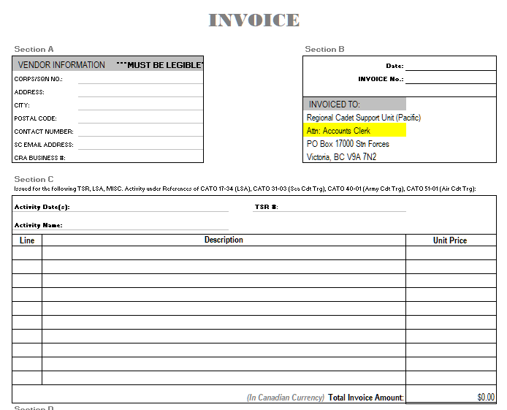

Slide 10
Invoice requirements:
The invoice number should following this format:
12 digits and it is highly recommended the sequence includes the corps/sqn 4 digit UIC, 4 digits year submitted, 4 digit sequence. (i.e.: 455620190001
The invoice date should be DD MMM YYYY
An original itemized bill with proof of purchase is required for all reimbursements:
If paid by cash/debit/credit, the itemized receipt is necessary. Cash payments must have a zero balance owing on the vendor receipt/invoice.
If paid by cheque the vendor receipt/invoice must show a zero balance. If not, you have to attach a copy of bank statement / endorsed cheque.
The invoice must be signed by the CO and SC rep (print name and sign)

Slide 11
Suggestion: Before you send the invoice
Attach the Original itemized receipt (It must be clear what was purchased) with proof of payment.
Register your invoice on some form of tracking so you know when you sent it and how much.
Check your receipt date to your activity date range? If not, justify why the date is different.
For all meals or entry fees, the corps/sqn must updates Fortress attendance that is where we get the source for the nominal roll. Failure to update Fortress will cause delay in payment or no reimbursement of that purchase. (Consider sending an attendance list signed by the CO).
Use a blank piece of paper to attach all receipts in the same line order as reflected on the invoice. Write the applicable line number from the invoice next to the receipt.

Slide 12
Common errors causing payment delays
Forgetting key information:
Invoice number
Stating that the claim is LSA (put on the “Activity Name” line)
Including proof of payment (can be photocopy)
Combining expenses on one line on the invoice (use a separate line for each receipt/invoice)
Combining receipts that straddle March 31 (before and after)
Not submitting the original expense receipt being claimed. If the original is lost you must submit a full explanation. You must include a form signed your CO asserting that the original is missing)
Use a blank piece of paper to attach all receipts in the same line order as reflected on the invoice. Write the applicable line number from the invoice next to the receipt.

Slide 13
Use an Invoice Register: This is a GREAT tool to help the SC keep track of the invoices and make sure they get reimbursed the same amount as they requested. -If the amount requested is different than the amount direct deposited into the SC bank account please contact LS Noemi Brunet at 250-363-7345 or noemi.brunet@forces.gc.ca

