Slide 1
BC Branch Updates
The Army Cadet League of Canada British Columbia Branch

Slide 2
BC Branch Updates
BC Branch Levy fee
Universal Membership
Local Support Allocation
Awards
Survey

Slide 3
BC branch requested documents
Every year, the ACLC BC Branch asks each Support Committee to forward the following reports NLT 31 January 2025 to cover the following dates:
For Example, in 2024, we will request September 01, 2023 - August 31, 2024.
Annual General Meeting Minutes
Yearend Financials
Current Inventory List of Support Committee purchased items
ACLC BC Branch will provide a 25% discount for providing the above documents for the BC Branch Levy Fee

Slide 4
BC Branch Levy Fee
Each year, the BC Branch Levy invoice is sent to each Support Committee in BC.
What does the Branch Levy fee pay for?
ACLC Insurance Program for Liability & Content Insurance coverage for ACLC SCREENED Volunteers
Army Cadet Service Medals & ACLC Volunteer Medals
Professional Development: Pillars Conference & Online Training
Member and Volunteer Support

Slide 5
BC Branch LeVy Fee
The RCSU(P) Official Population Count Number determines the Levy fee. This count does not reflect the current Corps population; it is months behind.
Please do not amend payment information within the Levy letter
New Change- The BC Branch will charge $20.00 per cadet.
This cost is lowered this year due to the new Universal Membership requirements
Questions?

Slide 6
ACLC Universal membership
On July 31, 2024, a significant milestone was reached. During our Special Meeting, the Army Cadet League of Canada, British Columbia Branch, approved Universal ACLC Membership. This decision marks a new era of inclusivity and participation for our members.
The Benefit of Universal membership is that it allows a member to have a voice, be heard, and vote! It also allows our members to be part of much larger organizations comprised of individuals who share their interests. As a Universal ACLC member, you will receive information directly from organizational leaders, participate in decision-making, and stay informed!
There are four types of Membership: Ordinary Life Corporate Associate
Please use the following link found on the ACLC Web Page to register: MiCharity (formsite.com)

Slide 7
ACLC Universal membership
Within Universal Membership, your dues can be paid to BC.
Being a BC Member allows you to vote at the BC and National AGM! An Ordinary membership costs $35.00 annually, with $30.00 of that money returned to the BC Branch.
Where does my $30.00 go?
The ACLC BC Branch will apply any funds collected from Universal membership to reduce the annual levy fee for Support Committees next year. We want to ensure that, wherever possible, money raised by our Support Committee STAYS WITH OUR COMMITTEE’S.

Slide 8
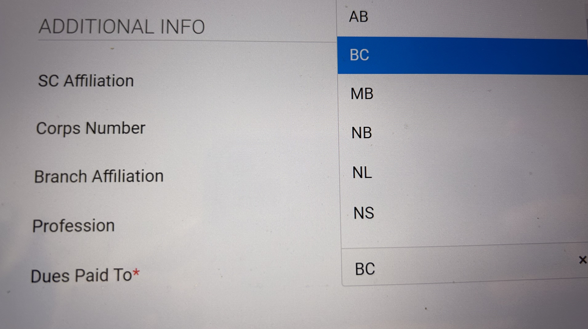
Universal membership
On the membership form -In Additional info/Branch Affiliation -Choose BC
It is the individual's responsibility to ensure the information is accurate and current.
Use your personal Email address. The membership is for the individual, not the position.
Review your application before submitting (auto-fill)

Slide 9
Choose British Columbia

Slide 10
Local Support Allocation
Local Support Allocation (LSA) is the method the RCSU/DND uses to provide financial relief to help offset some of the corps sponsoring committees' costs for supporting the cadet program.
NEW CHANGE:
RCSU Pacific must receive LSA invoices by 31 January 2025 (not 31 March).
LSA invoices - To maximize LSA reimbursement, we suggest invoicing RCSU for all your LSA expenses every three months;
end of June
end of September
end of December
LSA LINK:
LSA tracker FY 2024-2025.xlsx

Slide 11
ACLC Young citizens scholarship
This award of up to $5000.00 is designed to help cadets pursue post-secondary education and continue their leadership and community contribution journey.
Open to cadets in their final year of high school or graduates applying for accredited Canadian institutions
Due April 1, 2025
Award Policy: https://www.armycadetleague.ca/wp-content/uploads/POLICY-17-3-YCF-Scholarship-Bilingual-Jan-2016.pdf
Application Link: https://fs2.formsite.com/aclc/YoungCitizensFoundation/index.html

Slide 12
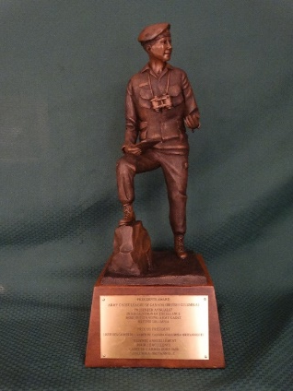
Presidents Award
The ACLC BC Branch will recognize annually one deserving Outstanding Army Cadet in the Pacific Region who has demonstrated leadership, initiative, mentorship, and dedication to supporting the Army Cadet Program in their community
Eligibility:
be a recipient of the Royal Canadian Army Cadet Medal of Excellence
Be a serving cadet on the date of nomination and continue to serve until 01 June the proceeding year
Be Master cadet qualified
Be regarded as an excellent ambassador of the RCACC program
Have completed an advanced training summer course or participated in national-level directed activity

Slide 13
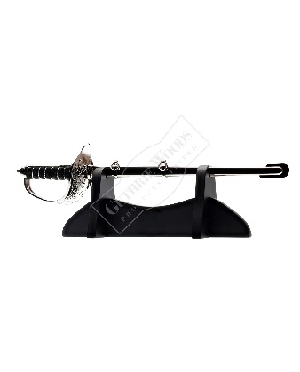
Presidents Award
How to Nominate: nominations must come from the Corps CO
A copy of the Cadet record from Fortress
Recommendation letter from the CO
Recommendation letter from the Support Committee
Recommendation letter from the School/Principal
Grades from the current year in School
The due date for nominations is 30 April 2025

Slide 14
BC Branch Volunteer training survey
The purpose of the survey is to determine online and in-person Volunteer training for the next cadet training year from September 2025 to June 2026
The survey will be sent to all Support Committee within the next few weeks
Please take the time to complete the survey! Your voice matters to us!
Raffle for a Gift Card

Slide 15
Important dates
By January 2025: Support Committees should have completed:
Annual General Meeting
National Screening for new and returning volunteers
Submitted LSA receipts
Submitted BC Levy fee and Requested Documents
February 10, 2025, Online Support Committee Chat
10 March 2025 Online Support Committee Chat
01 April 2025 Young Citizens Foundation Scholarship is Due
30 April 2025 Nominations for the President’s Outstanding Army Cadet in BC due

Slide 16
Thank you!
For any questions, please contact:
The Army Cadet League of Canada BC Branch through
the Executive Director at
execdir@armycadetleague.bc.ca
Please check out the Branch Web Site for updated information
www.britishcolumbia.armycadetleague.ca

